Slide 1
How to Swivl LIVE

Slide 2
With Swivl Live we support every major methodology of instructional coaching, including real-time, remote observations.

Slide 3
Live Listening
Swivl Live Use Cases
Remote Learning
In-Ear Coaching
Distance Learning

Slide 4
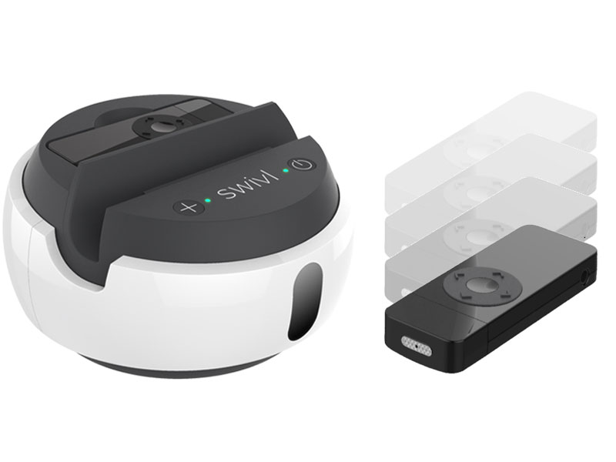
Live Listening
Use Swivl Live to check in on teachers or student teachers from a location that’s convenient for you.
See how a class or event is running without adding the disruption of a physical observer in the room.
With Swivl’s C5, see and hear every interaction between a student and teacher through the audio provided by the Primary and Secondary markers.

Slide 5
In-Ear Coaching
With Swivl Live, a coach can have a complete view of the classroom and a teacher’s interactions with students, live as they are occurring.
Teachers can use a standard mobile headset, which conveniently plugs into our Primary Marker, allowing them to hear the coach so that they can make adjustments in real-time.

Slide 6
Remote Learning
With Swivl Live, homebound students can remotely attend and participate in any class or event.
Connect a USB speaker to Swivl so all the students can hear the remote person.

Slide 7
Distance Learning
Swivl Live makes it easy to broadcast any lecture or event to the world.
Bring in a special guest lecturer or give access to your lesson to more students in more places.

Slide 8
Tracking and Wireless Audio
While using Swivl Live, your C-Series robot continues to track and follow the teacher, presenter.
The Markers continue to stream high quality audio.

Slide 9
Swivl Live Setup

Slide 10
Never Miss a Moment
Swivl is the only technology that allows you to conduct live and recorded classroom video observations
Swivl classroom video observations provide better data
With better data, teachers and coaches can achieve deeper insights
Deeper insights make teachers transformational

Slide 11
Questions
Webinar will be available on Twitter & Facebook @goswivl
Learn more about Swivl Live at www.swivl.com/swivl-live
Plans and Pricing swivl.com/cloud
What is Swivl? swivl.com/swivl
For purchasing information, contact sales@swivl.com

